Slide 1



X-AI Models

Slide 2
Lime Local Interpretable Model-agnostic Explanations
LIME emphasizes the critical need for explanations in machine learning models to foster trust. Users are more likely to trust and effectively utilize models if they understand the reasoning behind individual predictions and the overall model behaviour.
LIME is introduced as a novel technique that explains the predictions of any classifier or regressor in an interpretable and faithful manner. It works by approximating the complex model locally with an interpretable model, which helps users understand the prediction for a specific instance.

Slide 3
Lime Local Interpretable Model-agnostic Explanations
Model-agnostic nature, means it can explain predictions of any model without needing to understand the internals of the model itself.
For explanations to be meaningful, they need to be presented in an interpretable format. LIME uses simple, human-understandable representations (like binary vectors for presence/absence of words in text classification or super-pixels in image classification) even if the original model uses more complex features.
Reference: https://dl.acm.org/doi/abs/10.1145/2939672.2939778

Slide 4
SHAP (SHapley Additive exPlanations)
It is a framework for interpreting the output of machine learning models. It is based on Shapley values from cooperative game theory and is designed to provide consistent and accurate feature importance scores.
Shapley Values: Originating from cooperative game theory, Shapley values distribute the payout (prediction) fairly among the features based on their contribution to different coalitions (combinations of features).

Slide 5
SHAP (SHapley Additive exPlanations)
Local Explanations: SHAP provides explanations for individual predictions rather than for the model as a whole.
Global Explanations: By aggregating local explanations, SHAP can also provide insights into the overall behaviour of the model.
This is particularly valuable in fields like finance, where transparency, fairness, and trust are critical. Using SHAP, the bank can ensure that its loan approval model is not only accurate but also interpretable and justifiable to stakeholders.
Reference:
https://arxiv.org/abs/1903.02407

Slide 6
GRAD-CAm (Gradient-weighted Class Activation Mapping)
It is a technique used to provide visual explanations for decisions made by Convolutional Neural Network (CNN)-based models, making them more interpretable and transparent. Grad-CAM helps to provide transparency by showing which parts of an image are most influential in the model's decision-making process.
It is widely used in image classification and image captioning, object detection etc.

Slide 7
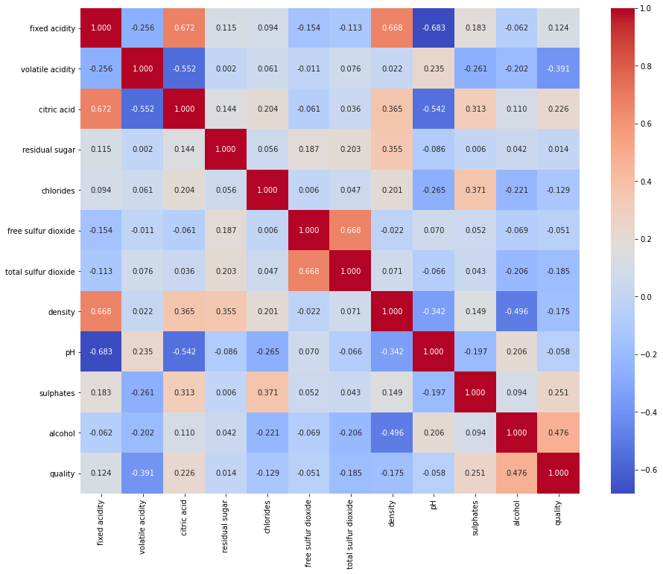
GRAD-CAm (Gradient-weighted Class Activation Mapping)
It generates the heatmap which highlight which part of image is contribute to the model result either in positive or negative.
By visualizing the regions of interest identified by Grad-CAM in correctly classified and misclassified images, you can gain insights into the strengths and weaknesses of your model.
Reference:
https://openaccess.thecvf.com/content_iccv_2017/html/Selvaraju_Grad-CAM_Visual_Explanations_ICCV_2017_paper.html

Slide 8
Integrated Gradients (IG)
Integrated Gradients (IG) is an attribution method used for explaining the predictions of deep neural network models. It assigns a relevance score to each input feature (e.g., pixels in an image) to explain the model's output prediction. This method is particularly valuable in image classification tasks, where it helps highlight the pixels that contribute most to the model's decision.

Slide 9
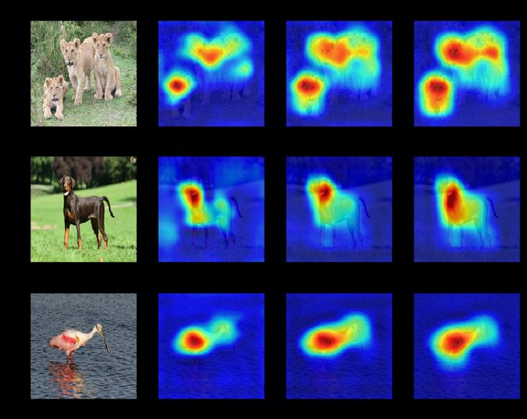
Integrated Gradients (IG) USE Cases
Image Classification: In image classification tasks, IG can be used to generate saliency maps that highlight the most important regions of an image contributing to the model’s
Medical Imaging: By visualizing which regions of medical images (e.g., X-rays, MRI scans) are most influential in the model's predictions, IG can provide valuable insights into potential disease indicators or anomalies.
It also used in NLP, Autonomous vehicles etc.
Reference:
https://ieeexplore.ieee.org/abstract/document/9413242

Slide 10

DeepLIFT (Deep Learning Important Features)
Deep-LIFT is a deep learning model designed to improve multilabel image annotation by precisely aligning semantic labels with their corresponding regions in an image.
Deep-LIFT is used in various real-world applications where accurate multilabel image annotation is crucial, such as scene recognition, human attribute recognition, medical diagnosis recognition, and more.
Reference:
https://ieeexplore.ieee.org/abstract/document/9352498

Slide 11
LRP (Layer-wise Relevance Propagation)
For a machine learning model to generalize well, one needs to ensure that its decisions are supported by meaningful patterns in the input data. A prerequisite is however for the model to be able to explain itself, e.g. by highlighting which input features it uses to support its prediction. Layer-wise Relevance Propagation (LRP) is a technique that brings such explainability and scales to potentially highly complex deep neural networks. It operates by propagating the prediction backward in the neural network, using a set of purposely designed propagation rules.

Slide 12
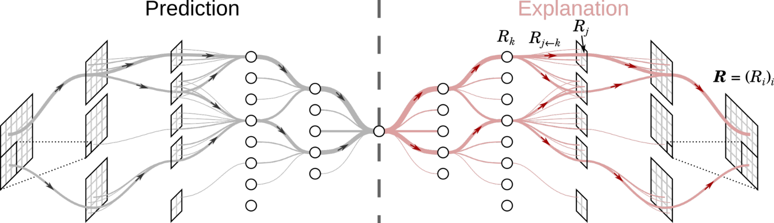
LRP (Layer-wise Relevance Propagation)
Identifying Model Biases: LRP can also be used to uncover biases present in deep learning models by revealing which features the model relies on most heavily when making decisions.
Reference:
https://link.springer.com/chapter/10.1007/978-3-030-28954-6_10

Slide 13
Counterfactual Explanations
Definition: Layer-wise Relevance Propagation (LRP) is a technique used in machine learning classification to provide explanations for model predictions.
Objective: LRP aims to highlight the smallest changes to the feature values that result in a different prediction from the original one made by a black-box classifier.
Classifier: LRP is applied to black-box classifiers, which are machine learning models like neural networks or ensembles that are not inherently interpretable.

Slide 14
Counterfactual Explanations
Minimality: LRP focuses on finding the minimal changes necessary to alter the prediction. However, the definition notes that the concept of minimality can vary depending on the context and objectives of the application.
Reference:
https://link.springer.com/article/10.1007/s10618-022-00831-6

Slide 15
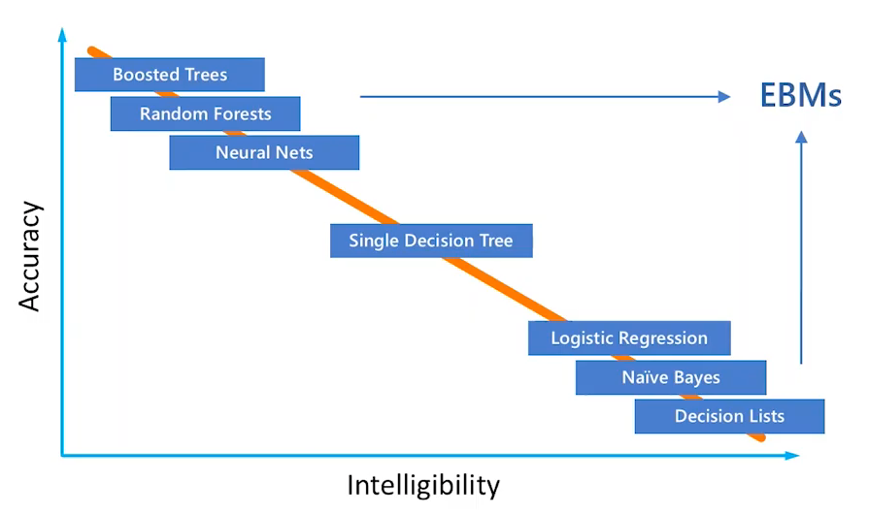
EBM (Explainable Boosting Machine)
An Explainable Boosting Machine (EBM) is a modern class of machine learning models that aims to offer a balance between accuracy and transparency.
Unlike "black-box" models such as random forests and deep neural networks, EBMs are considered "glass-box" models, meaning that they provide insights into how predictions are made.
Reference:
https://arxiv.org/abs/2311.07452

Slide 16
Rule based model (Decision Trees, Rule Lists)
Rule-based models are computational models that use a set of "if-then" rules to make decisions or predictions. These models are a type of expert system where the knowledge is represented in the form of rules, which are used to infer conclusions or take actions based on the input data.
The basic building blocks of rule-based models. Each rule is an "if-then" statement that specifies a condition (the "if" part) and an action or outcome (the "then" part).

Slide 17
Rule based model (Decision Trees, Rule Lists)
Rule-based models are highly interpretable because the rules are explicit and can be easily understood by humans. This makes them useful in domains where understanding the reasoning behind a decision is crucial, such as healthcare, finance, and legal systems.
Reference:
https://intapi.sciendo.com/pdf/10.1515/jaiscr-2017-0008

Slide 18
Which model used mostly now? (And why)
SHAP (SHapley Additive exPlanations) is currently one of the most widely used and researched methods.
It is due to
Community and Tool Support
Visualization
Local and Global Explanations

